Slide 1

Design Proposal
TEAM 10

Slide 2
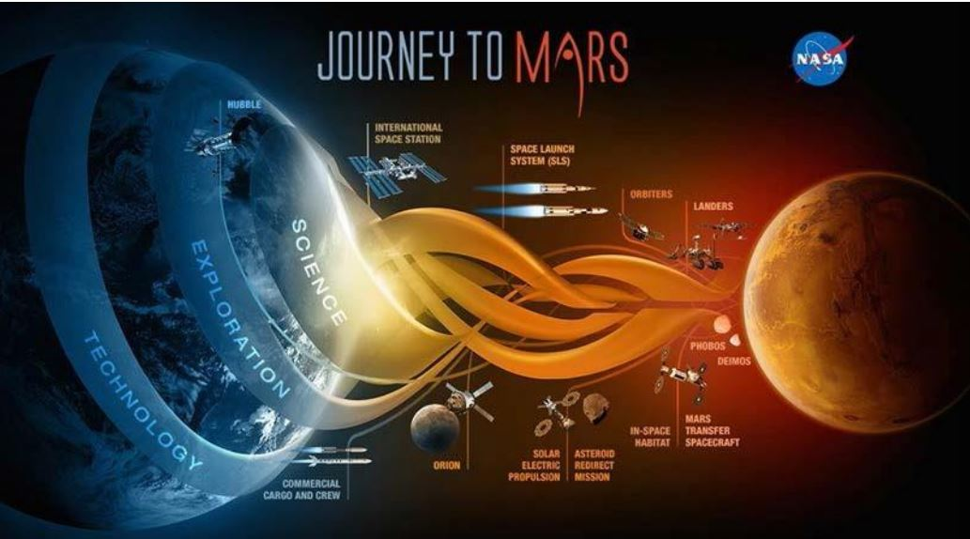
Background for Project
US long term plan to send humans to mars by 2030
Water and CO2 in regolith makes habitation possible
Using Mars’ resources to build is more efficient
Focus is collecting regolith to build shelter against radiation

Slide 3
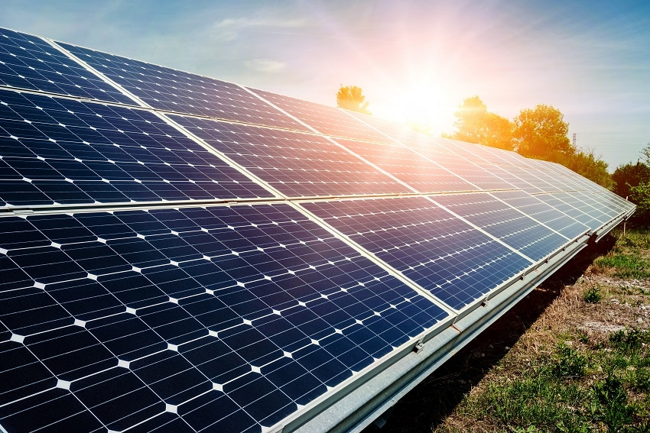
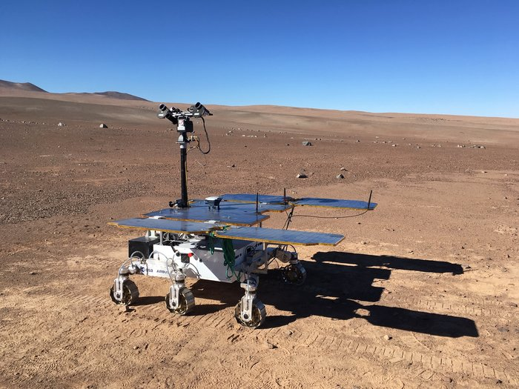

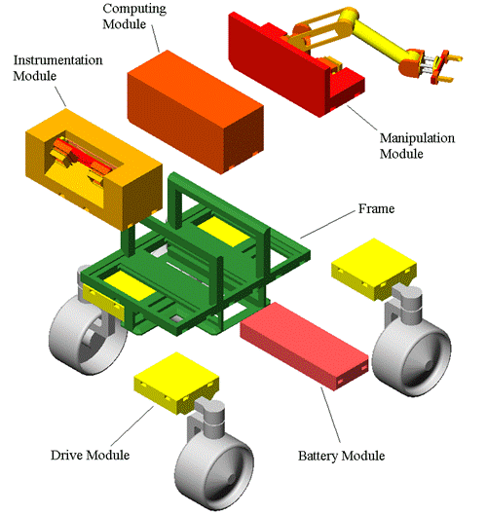
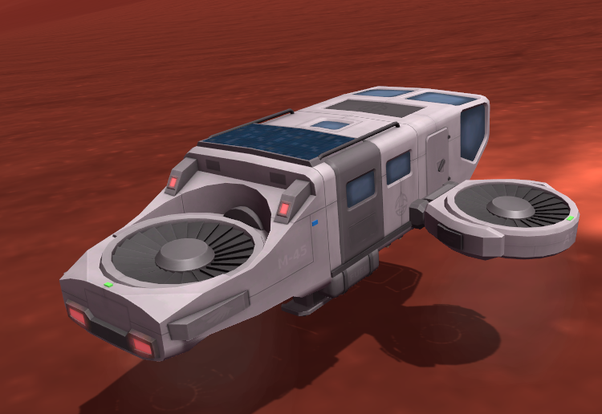
Objectives
The objective of the project is to build a rover which is able to transit on a “Mars-like surface” and collect the maximum amount of resources that are crucial to sustaining life on Mars.
Energy Consumption
Productivity
Operation
Our design will be assessed according to this criteria:
Innovation
Engineering Solutions
Notes:
Productivity: Mass of resources that is collected and successfully brought to the container in the assigned 4-minute period
Innovation: Marks will be allocated to groups who produce a machine that is able to incorporate systems that “think outside the box”.
Energy Consumption: The less amount of energy consumed the better
Operation: Do all the parts of the rover function correctly
Engineering Solutions: Effective design decisions which are innovative and functional

Slide 4
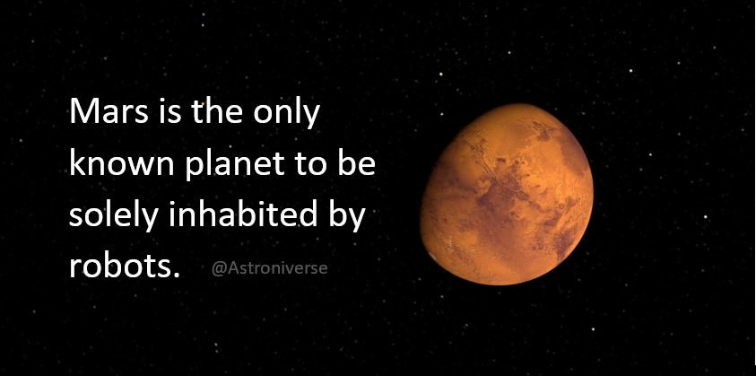
Project Goals
Produce a working prototype of a rover.
The rover must be built in ten weeks.
It must be able to move about on a Mars like surface and collect resources
It must operate continuously and collect as much regolith as possible in 4 minutes.
Notes:
Simplified problem statement - increase population of Mars!
Design and produce a rover prototype to collect regolith for 3d printing a radiation shelter.
Required to operate in a Martian environment (think sand and rocks), no oxygen etc
A high rate a of collection is better

Slide 5
Problem Statement
As part of their assessment for a first-year engineering programme students are required to produce a working prototype of a rover within approximately 10 weeks.
The rover needs to be able to transit through a Mars-like surface, simulated by the use of small rocks, sandhills and recesses and collect resources, which are simulated by small pebbles. It must operate continuously for 4 minutes and traverse an area approximately 9m^2.
The assessment will take into account whether a prototype is produced and the rate of regolith collection. Marks will also be given for energy efficiency and innovation.

Slide 6

Research
Talked to our mentor (previous champion!)
Read books (technical and general)
Looked at previous years designs
Research already built robots on instructables and other websites

Slide 7
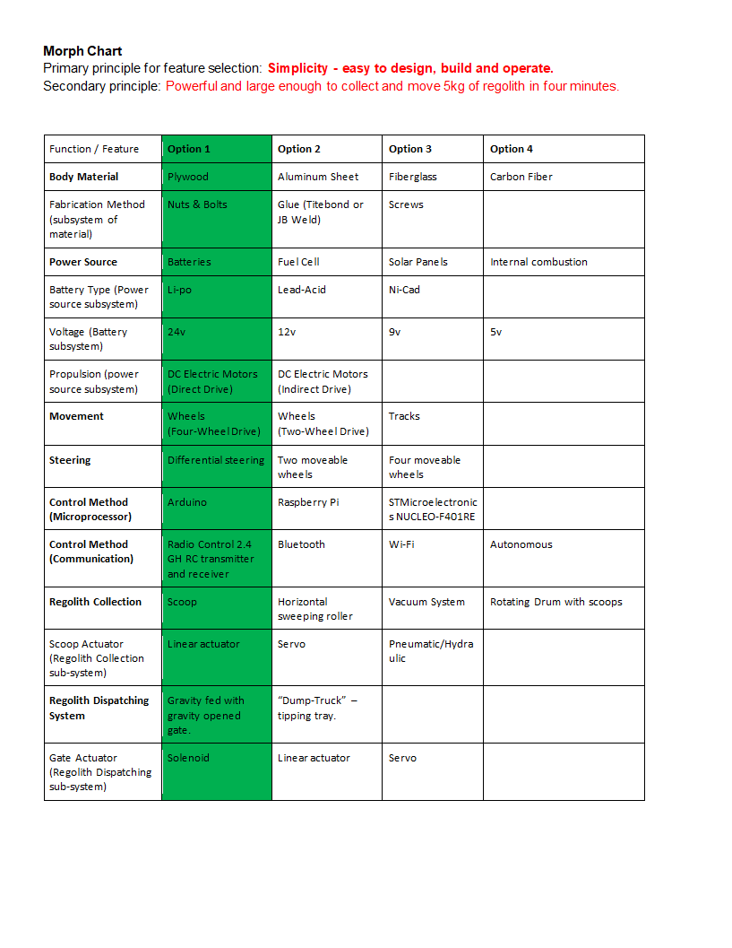
Morph Chart and Analysis
Focus on Simplicity
Few parts - easy to take apart and maintain
Plywood Construction
4 wheel drive with differential steering
Radio controlled
Arduino microprocessor
Scoop for collection
Gravity feed dispatching mechanism
Designed to collect and carry 5kg of regolith
Notes:
Simplified Morph chart - each design choice motivated by simplicity.

Slide 8
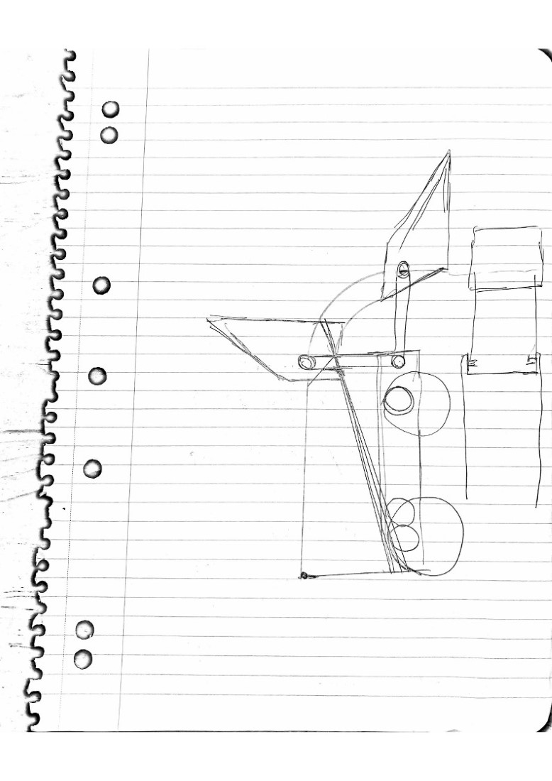
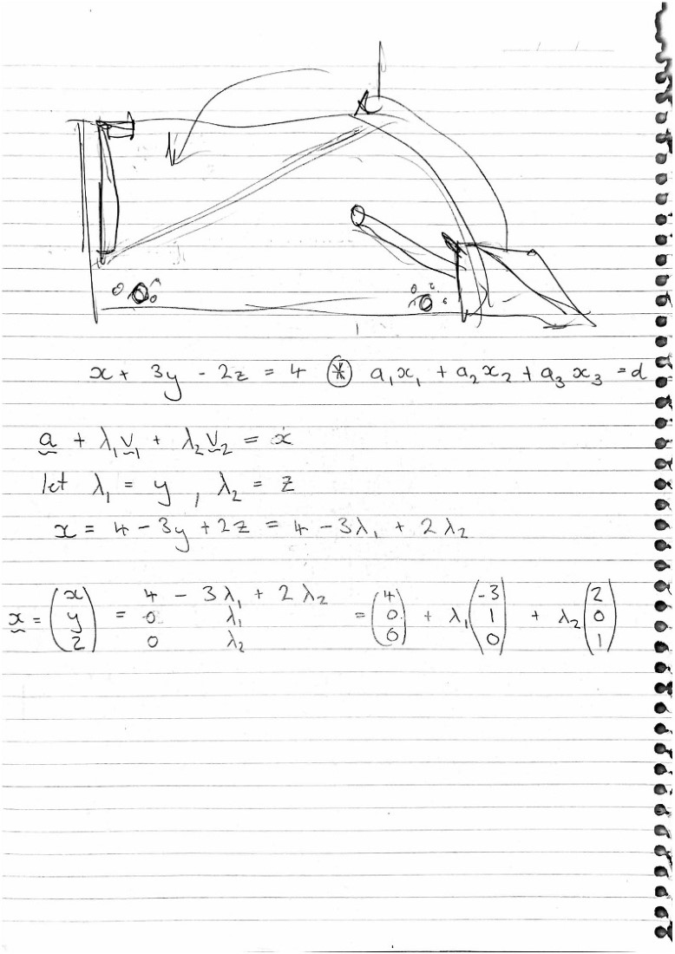
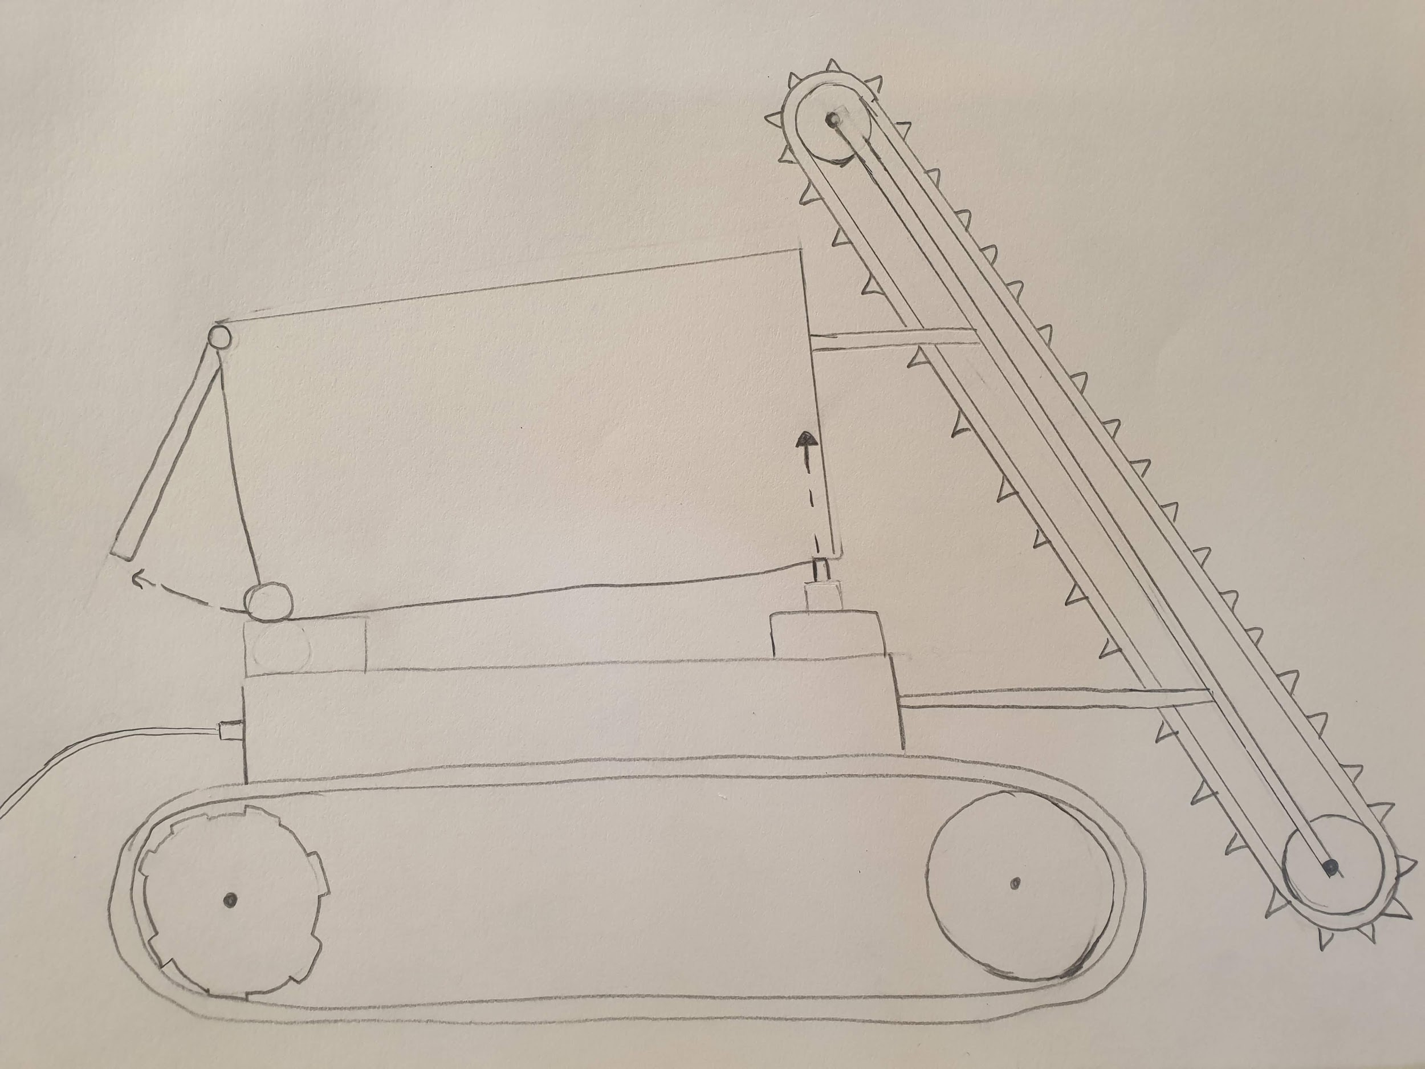
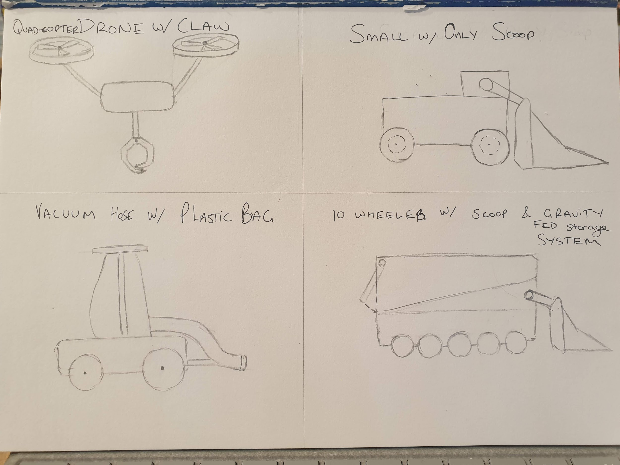
Concept generation & sketches

Slide 9
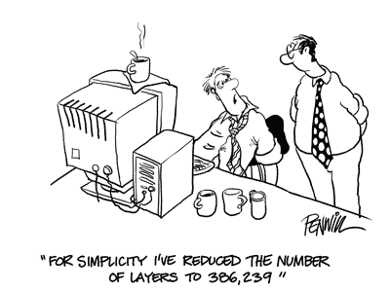
CAD Design
Designed in Fusion 360
Profile sketches easily downloaded for laser cutting
Made geometry of the Scoop easier to visualize and calculate
Renders make communicating design to team and clients easier

Slide 10
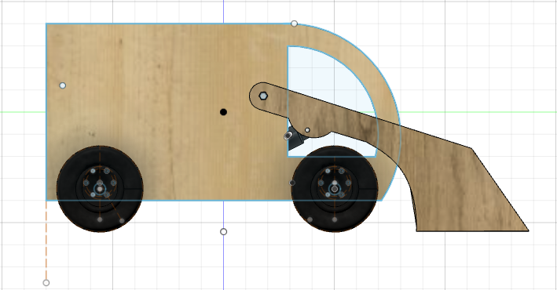
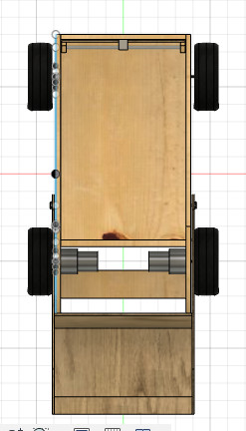
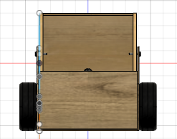
CAD Profiles

Slide 11

Design Concept Prototype
Light and strong with large capacity (5kg regolith)
Powerful (24 Volt 4 wheel drive and 500N linear actuator)
Easy to maintain and operate

Slide 12
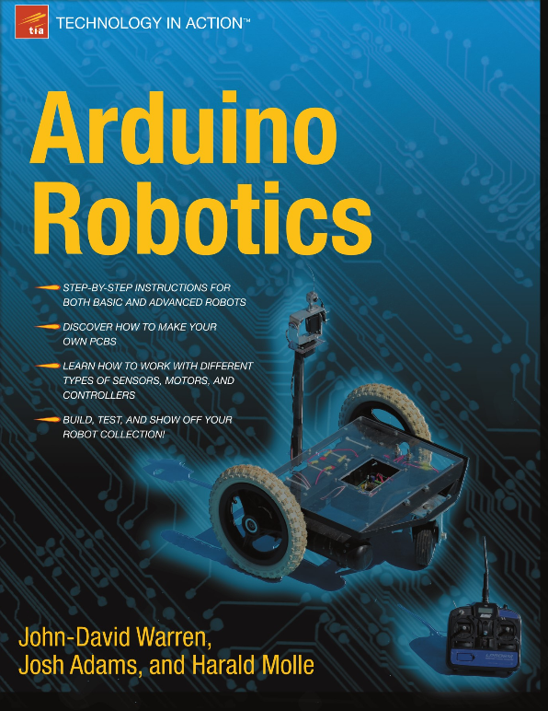
Electronics & Control System
Control system is 2.4 Gh RC transmitter and receiver
Arduino Mega with 3x H-Bridge MOSFET Motor Controllers
128 bit rotary encoder for arm position
RC servo to open dispatching gate
Hall effect current sensor as fuse/ energy use measurement
Code adapted from ‘Arduino Robotics’ (Warren et al. 2011)

Slide 13
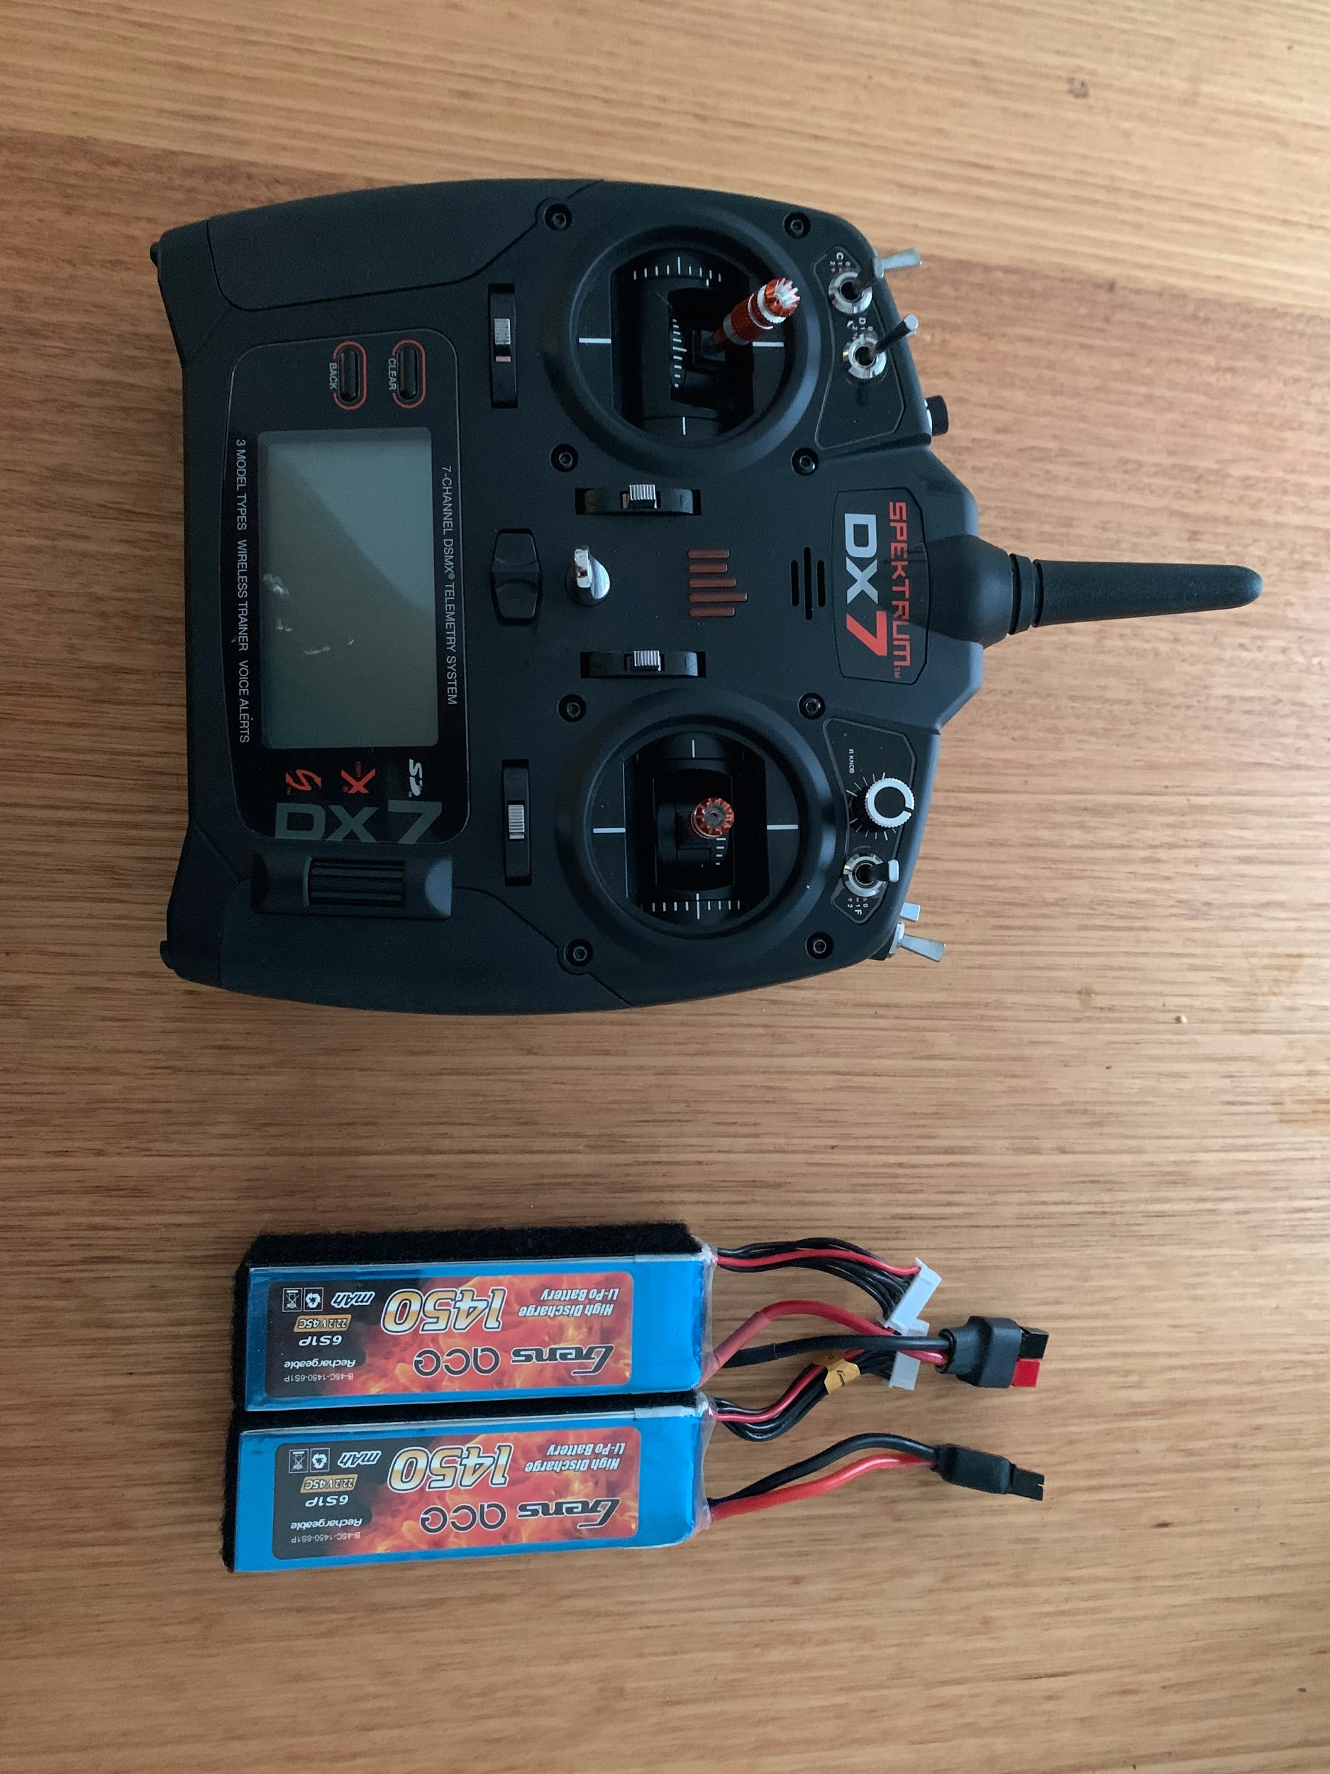
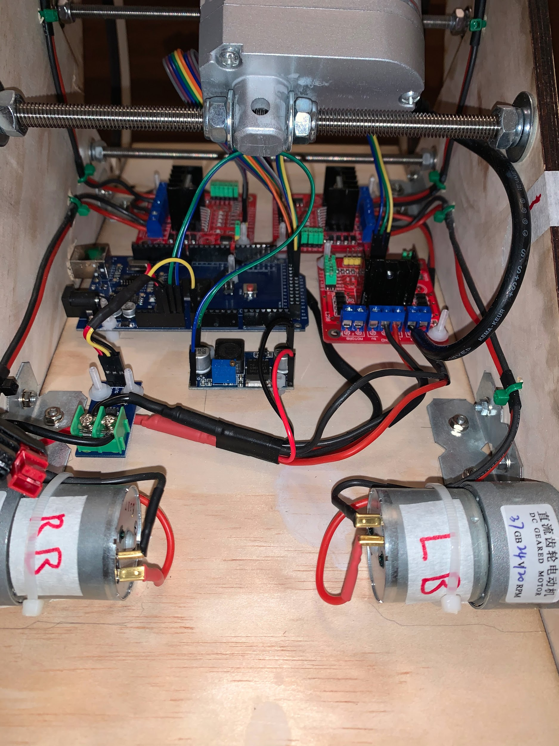
Electronics & Control System

Slide 14
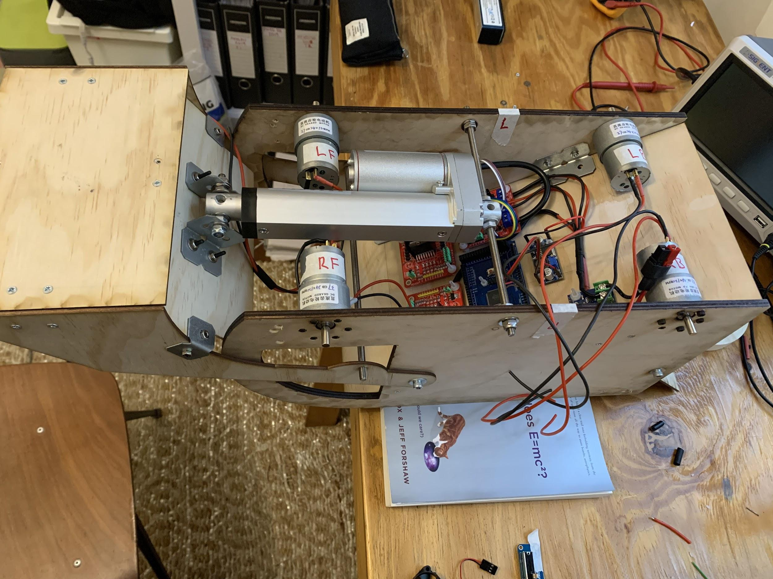
Project update - April 2nd
Body assembled
Electronics installed
Waiting on receiver and wheel shafts
Regolith collection and dispatch testing next week

Slide 15
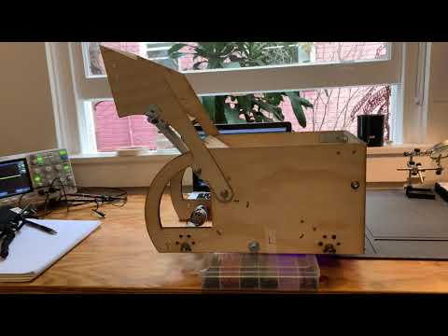
Notes:
Scoop test! Thanks for watching!

Slide 16
Conclusion
The rover:
plywood - main material; scoop connected to collect regolith
simple base with 4 wheels and axles - movement
radio control - communication, programming - Arduino
Lithium polymer batteries - power source
Box - storage & transportation
Gravity fed & hatch release
Follows the objectives: efficiency, flexibility, energy consumption
Future work
Daniel - constructing prototype
Other team members - helping software and presentations

